Slide 1
Embedded Operating Systems
2 Operating System Structure
(Linux)
Shripad V Deshpande

Slide 2

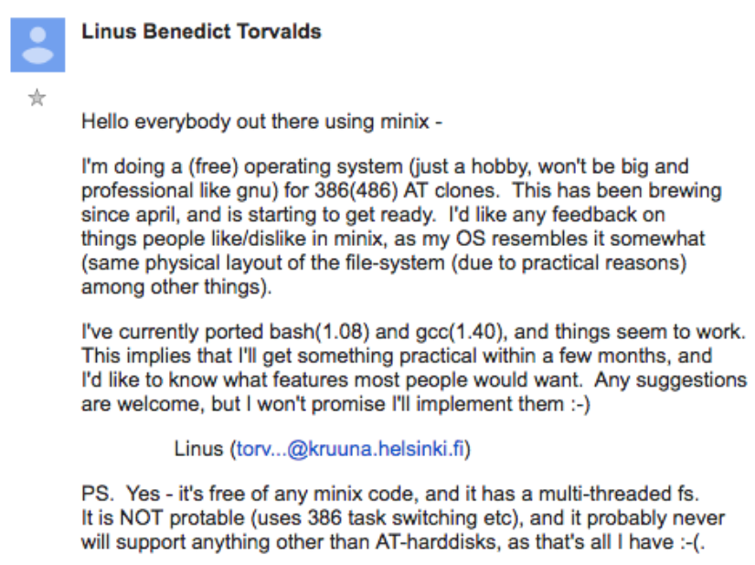
Linux – history
Linux is a Unix clone written from scratch by Finnish Computer Enthisiast Linus Torvalds with assistance from a loosely-knit team of hackers across the Net
It all started with a simple e-mail written by Linus on the comp.os.minix discussion forum on 25 Aug 1991,

Slide 3
Linux – What is it
The predecessors of Linux are Unix and Minix. Unix is a multitasking, multi-user computer operating system originally developed in 1969 by a group of AT&T employees at Bell Labs.
Minix was a Unix-like OS written from scratch by Andre Tannenbaum. It was the first OS with freely available source code.
Linux and Unix strive to be POSIX compliant.
Over 96.4% of the top 1 million web servers are Linux, and is the only OS used on TOP500 supercomputers in the world
The Android phone and the Kindle run Linux.

Slide 4
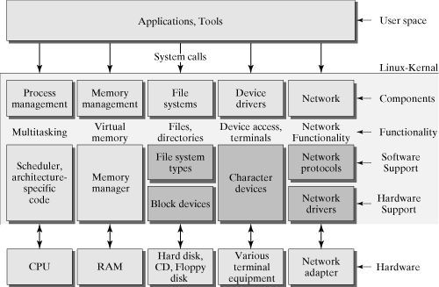
Linux Kernel Architecture

Slide 5
The Linux Philosophy
The *Nix Philosophy of Doug McIlroy
Make each program do one thing well. To do a new job, build afresh rather than complicate old programs by adding new features.
Expect the output of every program to become the input to another, as yet unknown, program. Don't clutter output with extraneous information. Avoid stringently columnar or binary input formats. Don't insist on interactive input.
Use tools in preference to unskilled help to lighten a programming task, even if you have to detour to build the tools and expect to throw some of them out after you've finished using them.
Notes:
Source: http://www.faqs.org/docs/artu/ch01s06.html

Slide 6
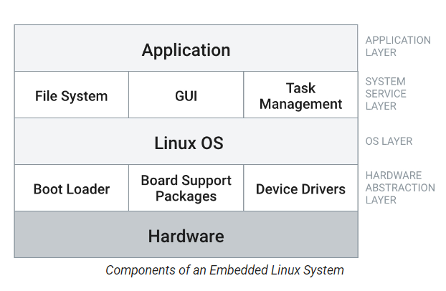
Embedded Linux Structure

Slide 7
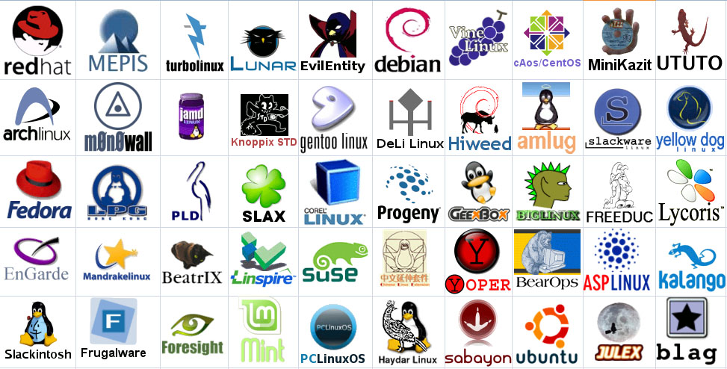
Linux Distributions
Notes:
Logos source: http://www.muylinux.com/wp-content/uploads/2009/04/logos-distros.jpg

Slide 8
Why Linux
A Linux Distribution has thousands of dollars worth of software for no cost.
Linux is a complete operating system:
Stable - the crash of an application is much less likely to bring down the OS under Linux.
Reliable - Linux servers are often up for hundreds of days compared with the regular reboots required with a Windows system.
Extremely powerful
Linux provides a complete development environment.
Excellent networking facilities
Ideal environment to run servers such as a web server, or an ftp server

Slide 9
Why Linux (cont…)
A wide variety of commercial software is available if not satisfied by the free software
Easily upgradable.
Supports multiple processors.
True multi-tasking, multi-user OS.
An excellent window system called X, the equivalent of Windows but much more flexible.
Full source code is provided and free.

Slide 10
Why Linux for embeded
Cross-compilation for any supported platform
Community reflection of Common Vulnerabilities and Exposures (CVE) fixes in updated releases
Deployment to commonly used Linux infrastructure and tools
Modern, cloud-native environment
Broad hardware support
Product lifecycle through community LTS

